Slide 1
Modeling Workflow
Why did we split our data?
Adam Gomez
Cohort: Mirzakhani
Date: Oct 20, 2022

Slide 2
Traditional Programming vs. Machine Learning
Traditional: You provide the data and the rules. The machine provides the output.
Machine Learning: You provide the data and the output. The machine provides the rules.
Input (X1) | Input (X2) | Output (y)
1 | 3 | 2.5
3 | 7 | 6.5
4 | 10 | 9.0
0 | 1 | 0.5
FUNCTION
a.k.a. “Model”
INPUT (X1, X2, …)
a.k.a. “Features”
OUTPUT (y)
a.k.a “Target”

Slide 3
Process Map
“In-Sample Evaluation”
“Out-of-Sample Evaluation”
Training Models
Evaluate Performance
On Train Dataset
Evaluate Performance
On Validate Dataset
Evaluate Performance
On Test Dataset

Slide 4

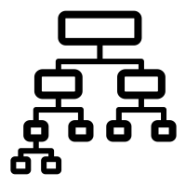
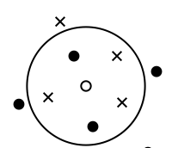
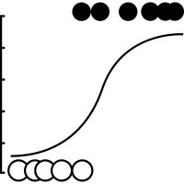
Training the Model
The computer looks at the relationship between the features and the target and develops a set of rules (a model) for how they are related. We can develop different rule sets based on different algorithms.
Train
Validate
Test
Feature A
Feature B
Feature C
Target
5
1.2
0
Yes
A
B
6
0.9
1
No
3
1.5
1
Yes
C
D

Slide 5
Process Map
“In-Sample Evaluation”
“Out-of-Sample Evaluation”
Training Models
Evaluate Performance
On Train Dataset
Evaluate Performance
On Validate Dataset
Evaluate Performance
On Test Dataset

Slide 6

Evaluate Performance Using the Train Dataset
We then ask each model to make predictions on the same data they just learned from based on the rules they identified. Some models are identified as very poor performers.
Train
Validate
Test
Feat. A
Feat. B
Feat. C
A
B
C
D
Target
5
1.2
0
A
B
Yes
No
Yes
Yes
Yes
6
0.9
1
Yes
Yes
Yes
No
No
3
1.5
1
Yes
No
No
Yes
Yes
C
D

Slide 7
Process Map
“In-Sample Evaluation”
“Out-of-Sample Evaluation”
Training Models
Evaluate Performance
On Train Dataset
Evaluate Performance
On Validate Dataset
Evaluate Performance
On Test Dataset

Slide 8
Evaluate Performance Using the Validate Dataset
We then give data from our validation set to the models that survived the first check, and see what they predict. Only the ONE best performing model makes it past this stage.
Train
Validate
Test
Feat. A
Feat. B
Feat. C
A
D
Target
2
1.6
1
Yes
Yes
Yes
5
0.4
0
No
Yes
Yes
A
D
7
1.9
1
No
No
No

Slide 9
Process Map
“In-Sample Evaluation”
“Out-of-Sample Evaluation”
Training Models
Evaluate Performance
On Train Dataset
Evaluate Performance
On Validate Dataset
Evaluate Performance
On Test Dataset

Slide 10
Evaluate Performance Using Test Dataset
The best performing model is then tested against our final set of “out-of-sample” data.
This gives us the performance metrics we can show to our stakeholders.
Train
Validate
Test
Feat. A
Feat. B
Feat. C
D
Target
1
1.4
0
Yes
Yes
6
0.3
0
Yes
No
6
1.5
1
D
No
No

Slide 11
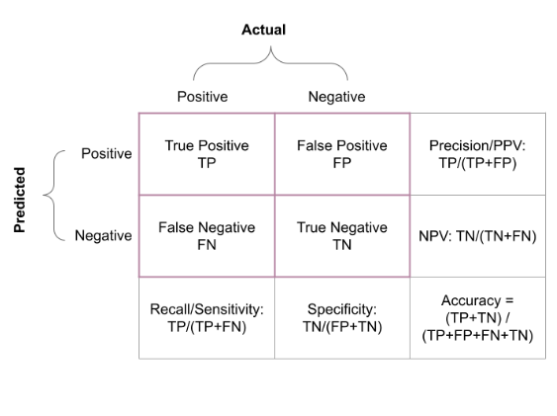
Confusion Matrix
Recall: How good were we at catching all the positives?
Maximize if false positives are not too bad (Cost of FN > Cost of FP)
Precision: When we said something was positive, how accurate were we?
Maximize if false positives are very bad (Cost of FP > Cost of FN)
Accuracy: How often were we simply correct?
Maximize if you don’t care which is low between recall and precision
F1-score: The harmonic mean of recall and precision.
Maximize if FP and FN are equally bad

Slide 12
Pop Quiz!
1. Suppose we made 4 different models. How many models will we evaluate against our TRAIN dataset?
a. None of them
b. One of them
c. Some of them (more than one)
d. All of them

Slide 13
Pop Quiz!
2. After looking at the performance of our models on our train set, how many models do we evaluate with our validation set?
a. None of them
b. One of them
c. Some of them (more than one)
d. All of them

Slide 14
Pop Quiz!
3. After comparing the performance of our models on our validate dataset, how many models will we evaluate using our test dataset?
a. None of them
b. One of them
c. Some of them (more than one)
d. All of them

